Slide 1

Exploring Treatment By Trial Interaction Using Treatment Stability/Trial Dendrogram Plots
Peter Claussen, Steve Gylling
Gylling Data Management, Inc.

Slide 2
Software Overview
ARM
Single trial management and analysis
ARM ST
Summarizes ARM trials across locations and years
Treatment means and treatment-trial interaction
Standard report format

Slide 3
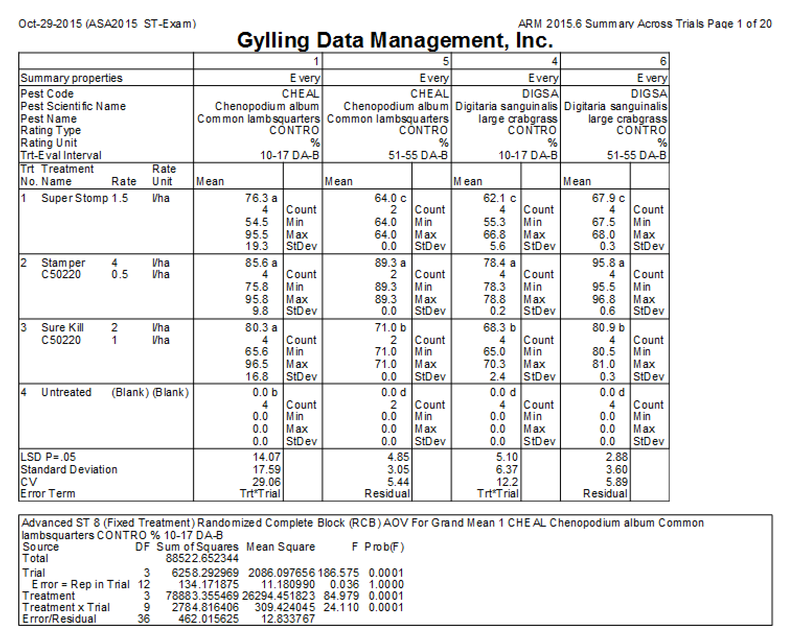
Standard Report Format
Treatment specific
statistics
Summary statistics
Analysis of Variance

Slide 4
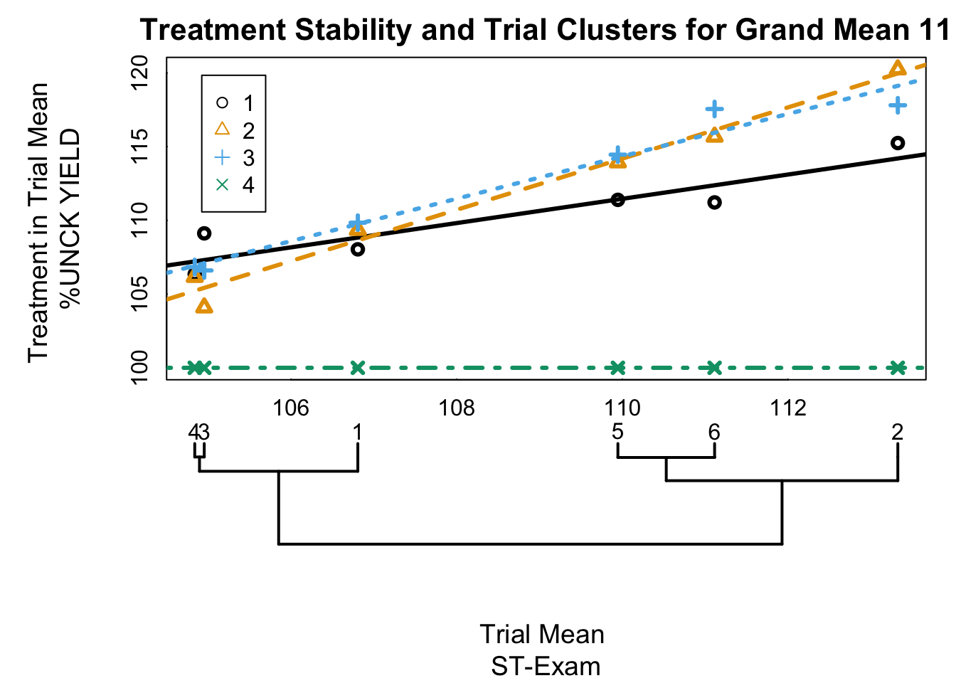
Treatment x Trial Graph
Treatment Stability
Trial Dendrogram

Slide 5
Statistical Model, Multiple Trials
plot assessment is the sum of
grand mean
i^{th} treatment
j^{th} trial
i^{th} treatment x j^{th} trial interaction
k^{th} block in j^{th} trial
experimental error
Notes:
Notation is adapted from Zobel

Slide 6
Decomposition of Interaction
Simple additivity
Single random variable
Proportional to product of main effects
Tukey 1949
Proportional to one main (trial) effect
Mandel 1961
Other decompositions
Milliken and Johnson 1989, Cornelius, et al., 2001
Notes:
[1] J. Mandel. Non-additivity in the two-way analysis of variance. Journal of the American Statistical Association, 56(296), Dec 1961.
[1] J. W. Tukey. One degree of freedom for non-additivity. Biometrics, 5(3):232–242, Sep 1949.
[1] P. L. Cornelius, J. Crossa, M. S. Seyedsadr, G. Liu, and K. Viele. Contributions to multiplicative model analysis of genotype-environment data. Proceedings of the Annual Meeting of the American Statistical Association, August 2001.

Slide 7
Treatment Stability
Regression of treatment x trial mean against trial mean or trial effect
Measure of treatment stability, relative to other treatments in the trials
Larger slopes (b) indicate treatments that are more sensitive to trial effects
Notes:
Notation is adapted from Zobel

Slide 8
Treatment Stability
Equal slopes implies no interaction
Regression of b_{ι} on treatment effects recovers nonadditivity parameter
Low correlation between b_{ι} indicate heterogeneous response among treatments
Notes:
Notation is adapted from Zobel

Slide 9
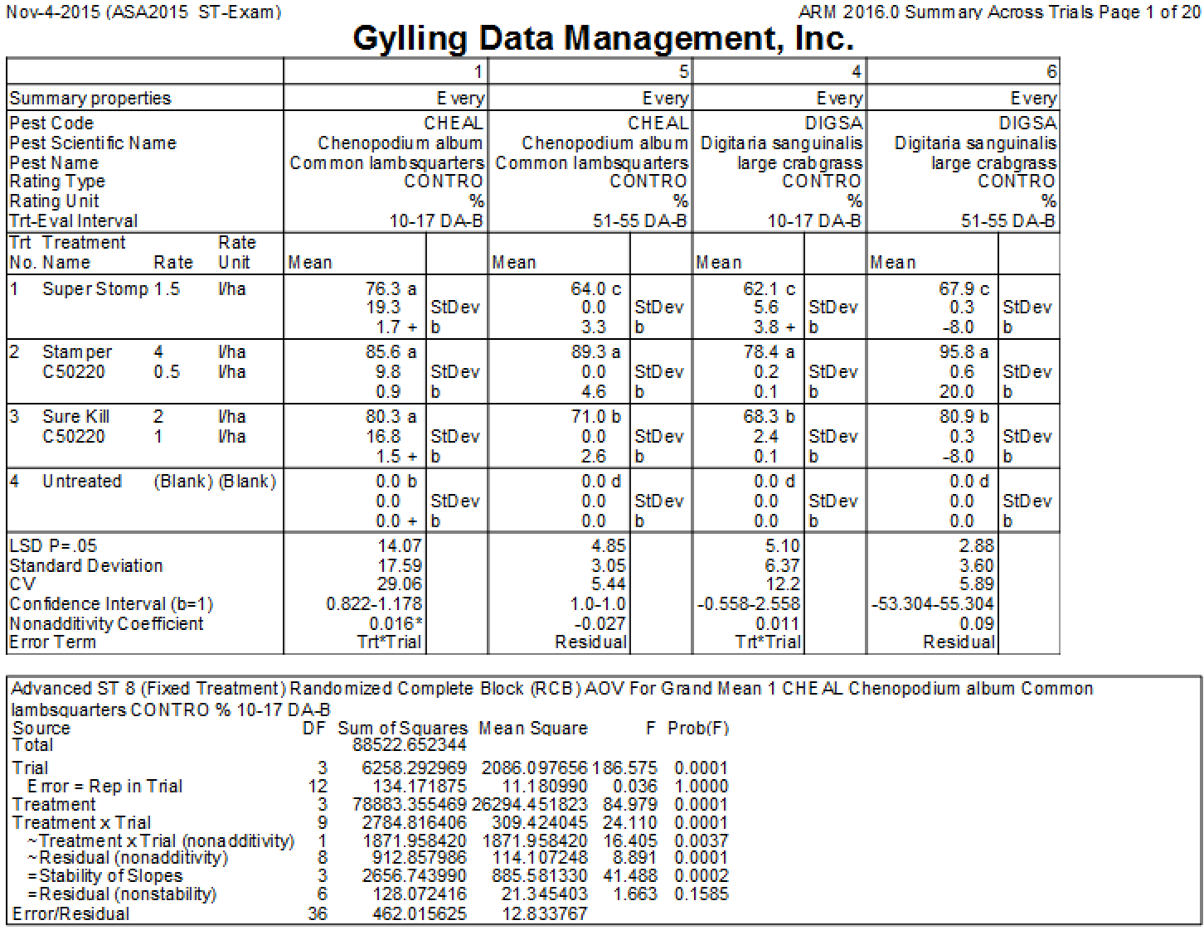
Report Additions
Treatment stability slopes
Non-additivity parameters
Additional decompositions

Slide 10
Trial Dendrogram
Treatment x trial means represented as a matrix, with trials in rows.
Each trial is a single multivariate response comprised of individual treatment means within trials.
Euclidean distance between rows computed using the R function dist()
The difference between trials is a measure of the pair-wise differences between treatments in different trial means.
Hierarchical clusters produced using the hclust()function
Dendrogram plotted by linking clusters

Slide 11
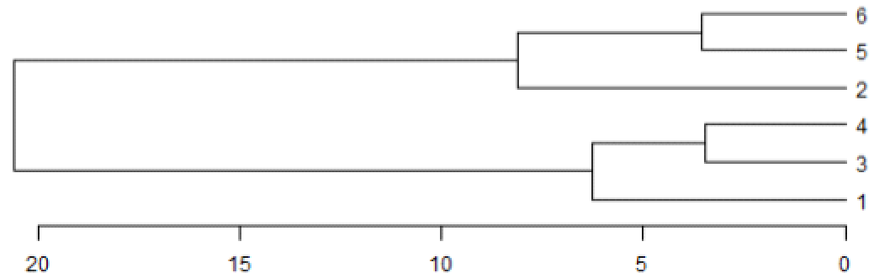
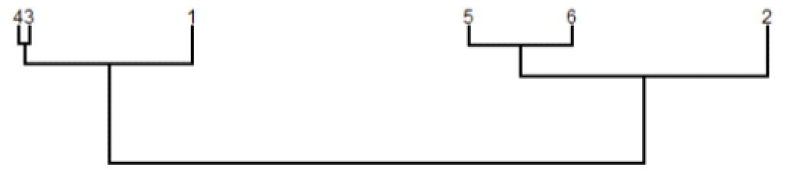
Trial Dendrogram
The default plot positions the end points (leaves) according to the branches identified by the clustering algorithm.
The ARM ST trial dendrogram constrains leaves to be aligned with trial means in the stability plot

Slide 12
Trial Dendrogram
To calculate a distance between,say, trial 1 and trial 2, represent each trial as a vector of treatment means:
and compute the root of the sum of squares of the pairwise differences

Slide 13
Trial Dendrogram
When distances are computed from treatment in trial means, treatment effects cancel and the distance is based on trial effect and treatment-trial interaction.

Slide 14
Trial Dendrogram
If interaction is absent, the distance between two trials is proportional to the difference between trial effects only.

Slide 15
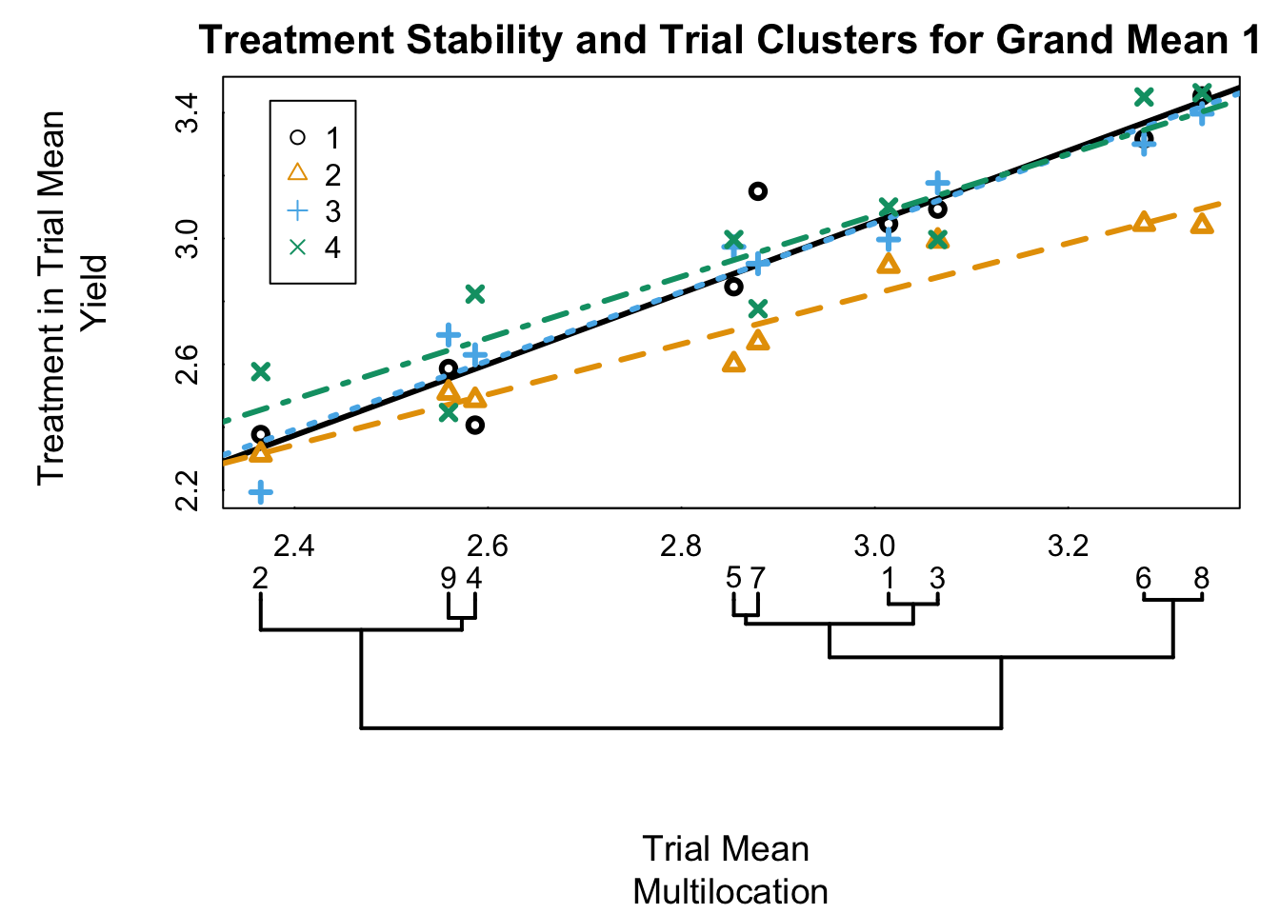
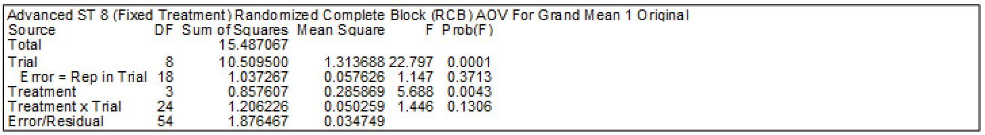
Simple Additivity
(Data from Littell et al., 1996)
Notes:
[1] R. Littell, G. Milliken, W. Stroup, and R. Wolfinger. SAS system for mixed models. SAS Institute, Cary, NC., 1996.

Slide 16
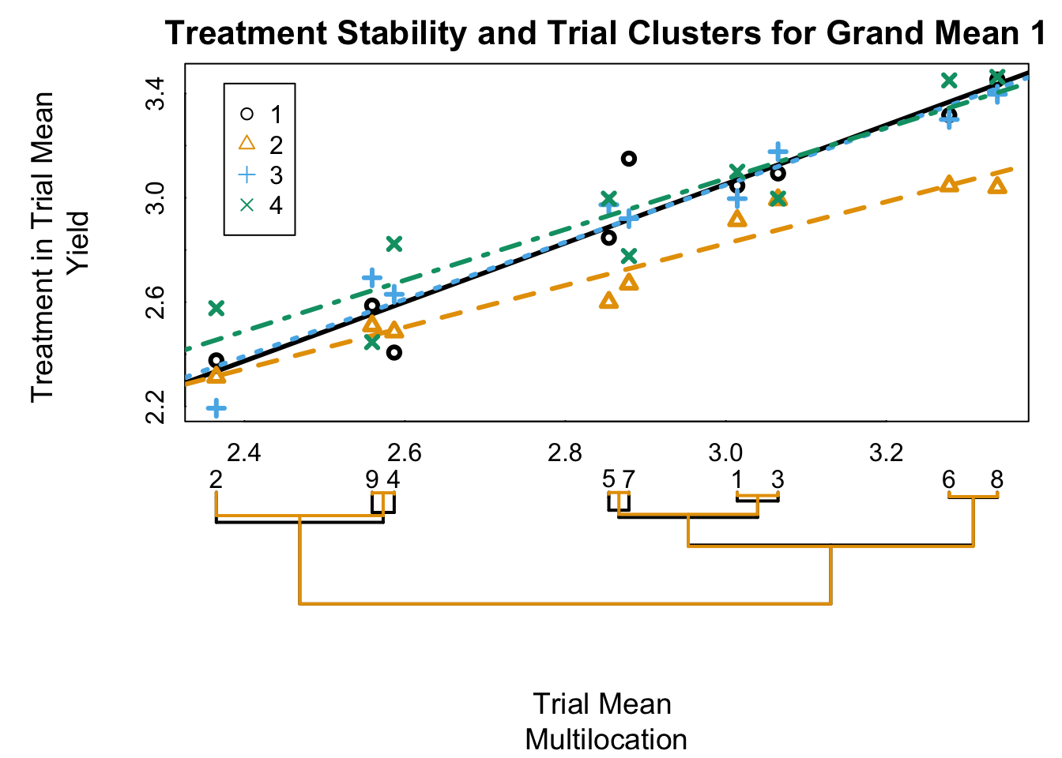
Simple Additivity
Reference dendrogram based on trial means is nearly identical to the treatment in trial means dendrogram

Slide 17
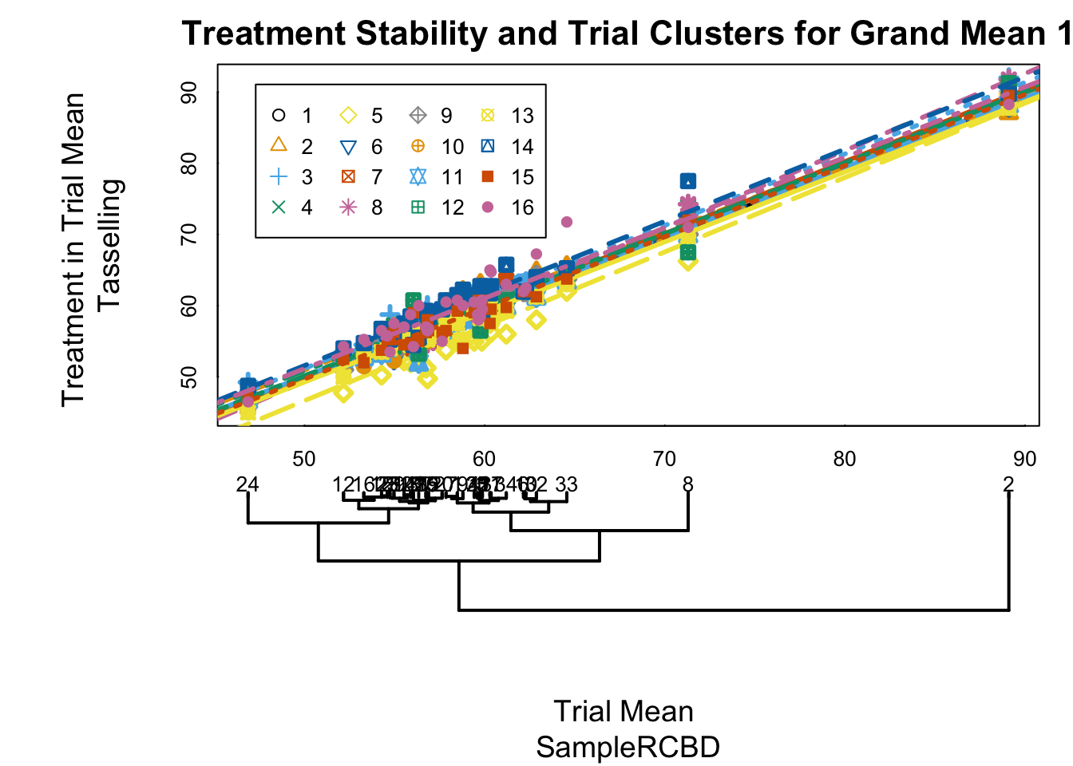
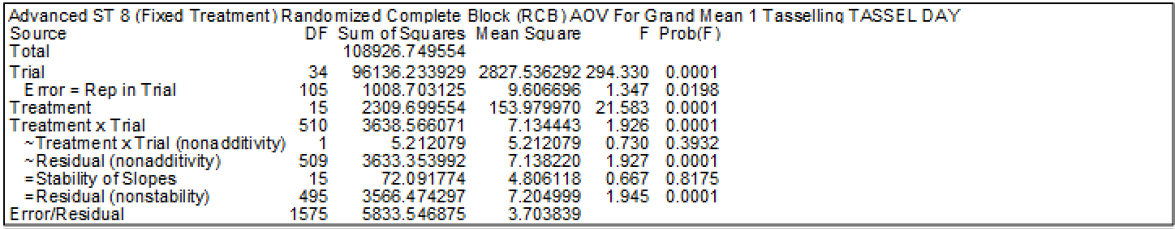
Random Effect
(Data from Vargas, 2013)
Notes:
[1] M. Vargas, E. Combs, G. Alvarado, G. ATLIN, K. Mathews, and J. Crossa. Meta: A suite of sas programs to analyze multienvironment breeding trials. Agronomy Journal, 105(1):11, 2013.

Slide 18
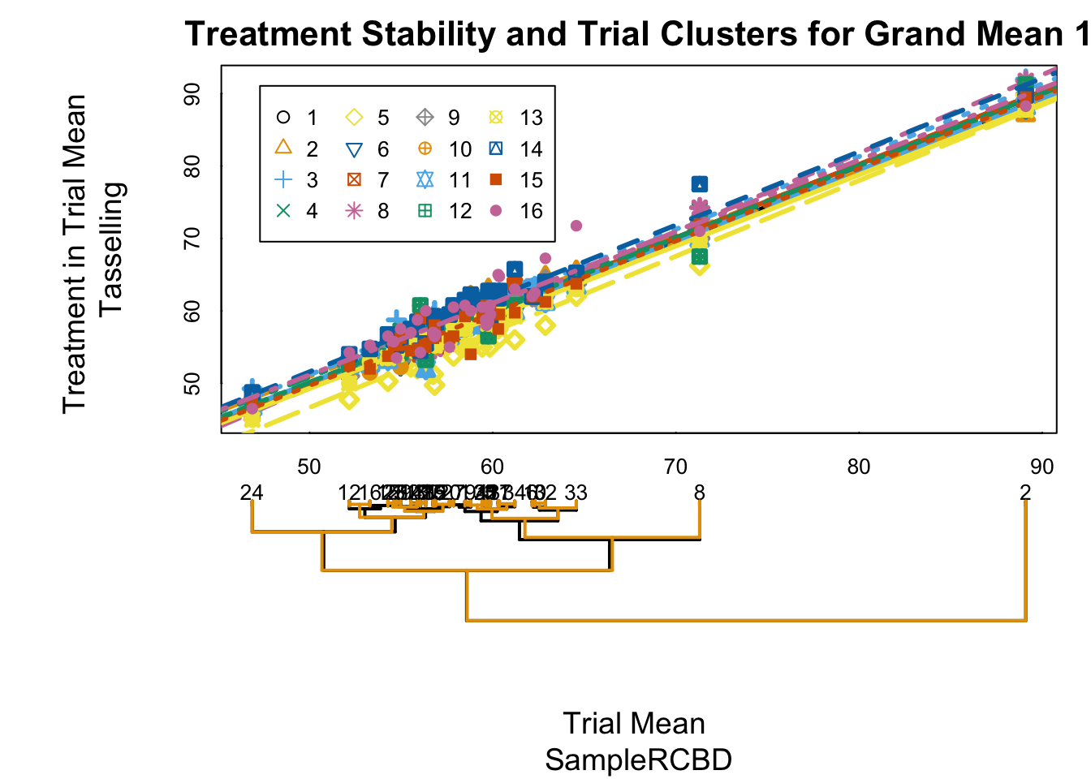
Random Effect
Interaction is present, but interaction effects cancel and dendrogram is preserved

Slide 19
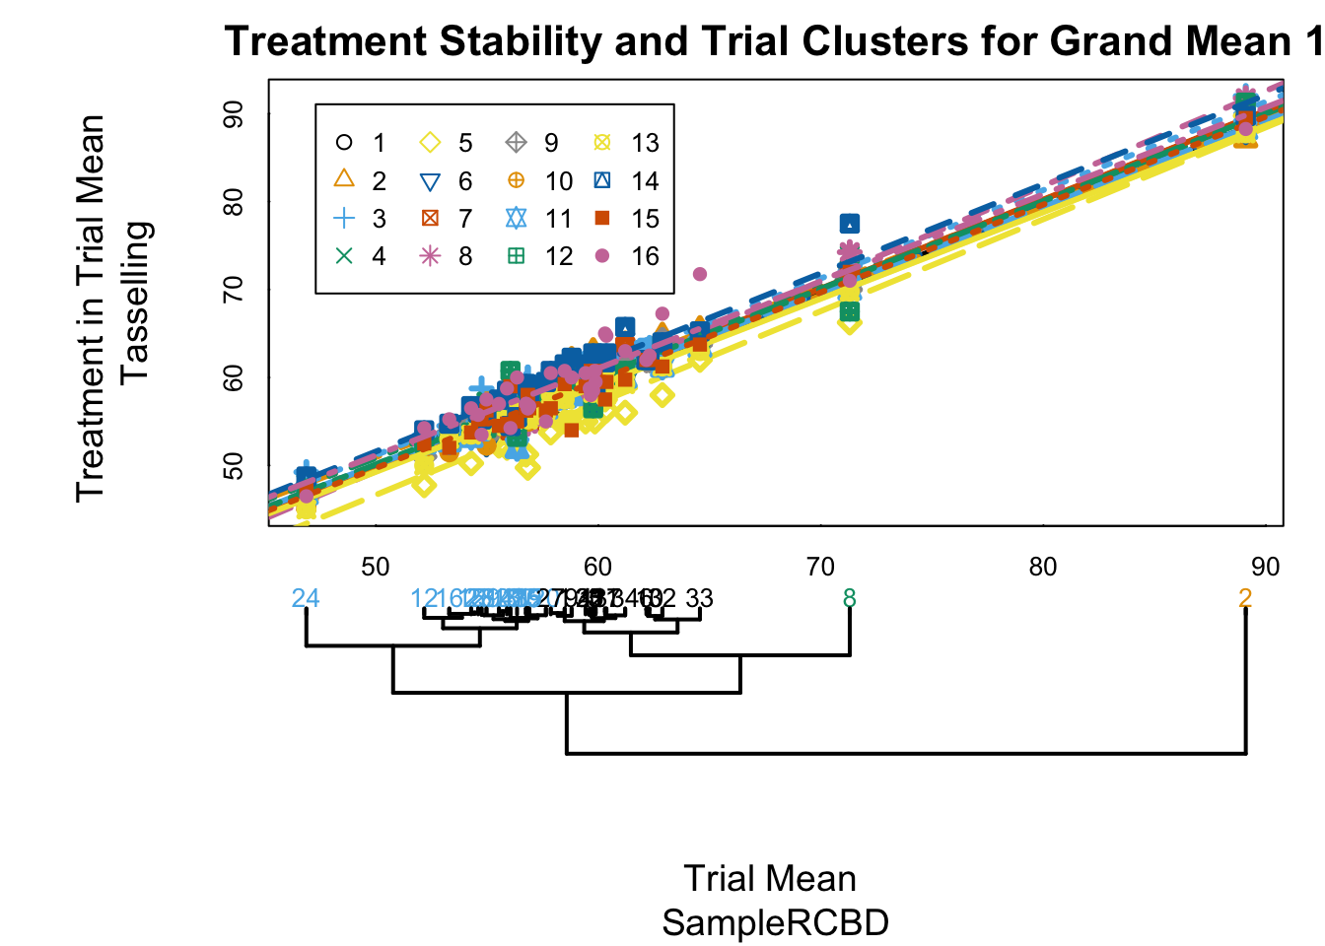
Random Effect
Interaction is present, but interaction effects cancel and dendrogram is preserved

Slide 20
Non-additivity
When interaction can be explained with a single non-additive parameter, distances between trials are proportional to trial effects

Slide 21
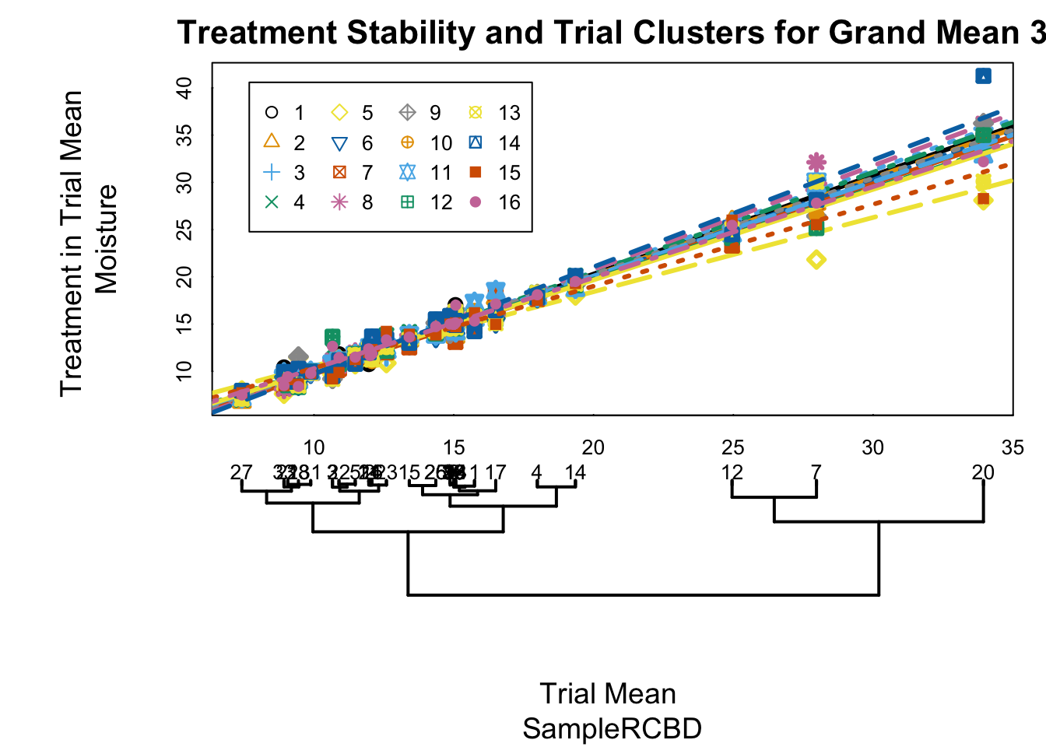
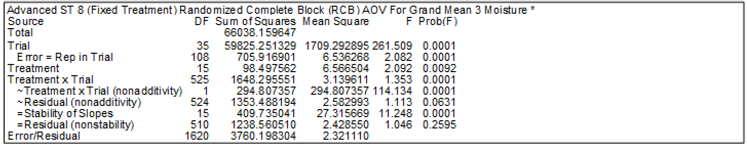
Nonadditivity
(Data from Vargas et al., 2013)

Slide 22
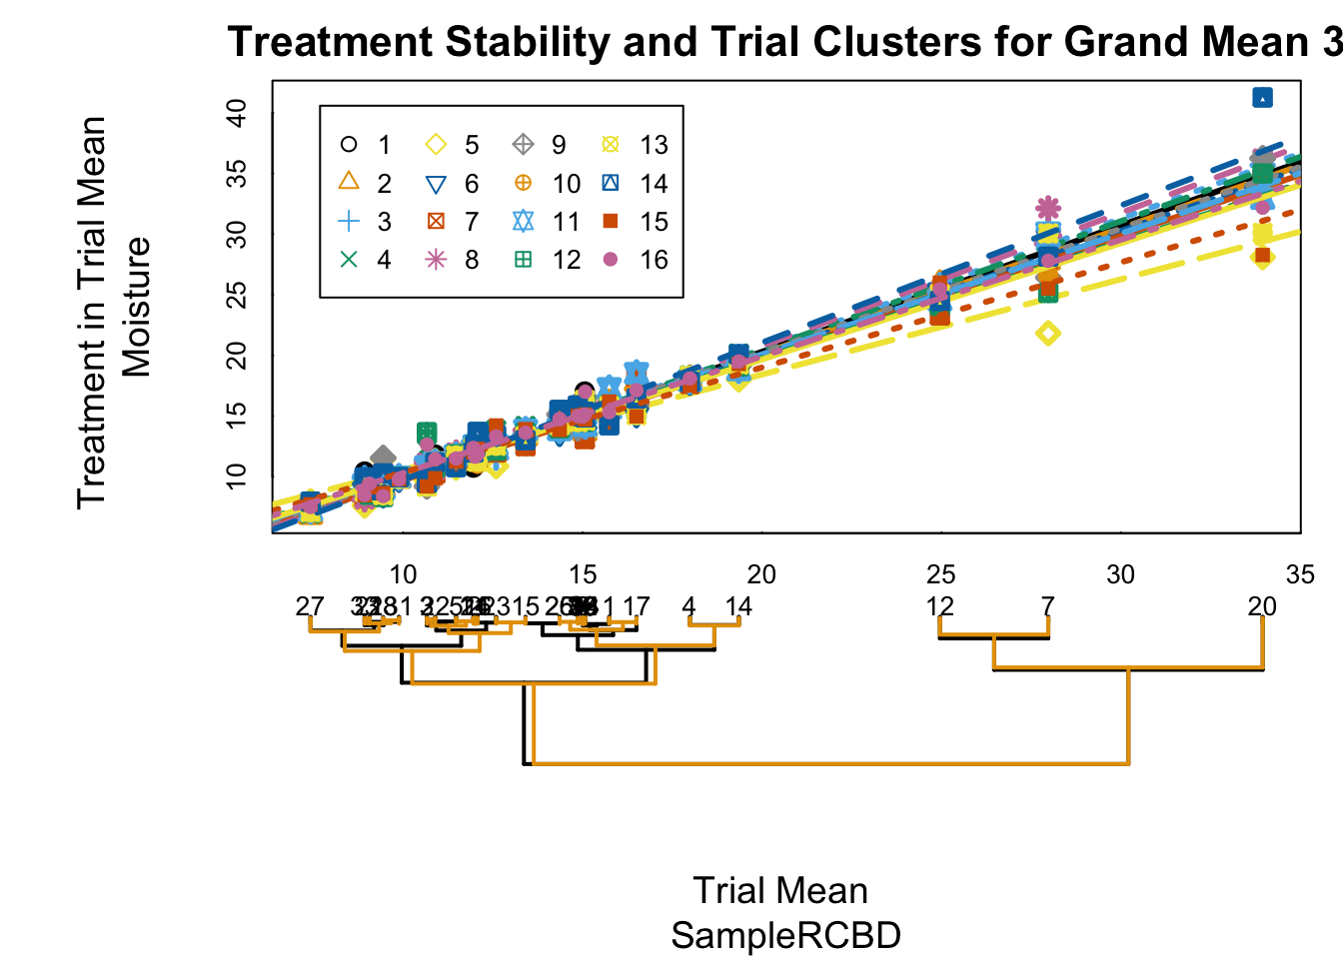
Nonadditivity
Dendrogram is largely preserved, but more distorted than simple random effect

Slide 23
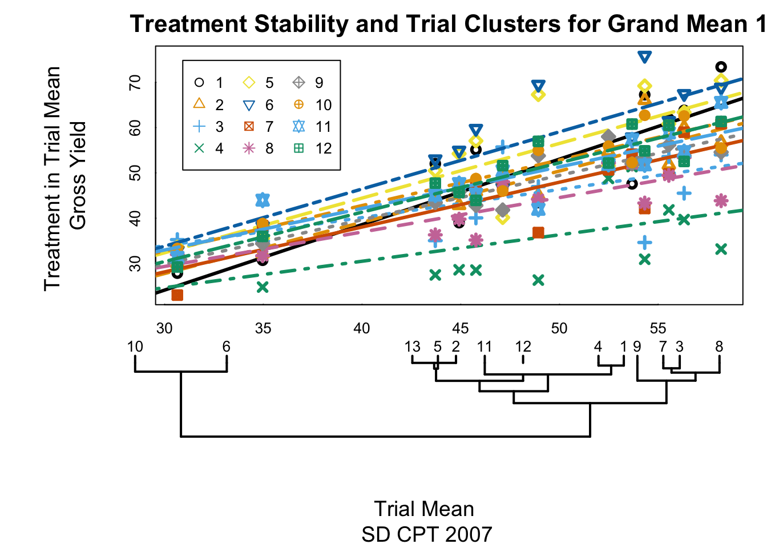
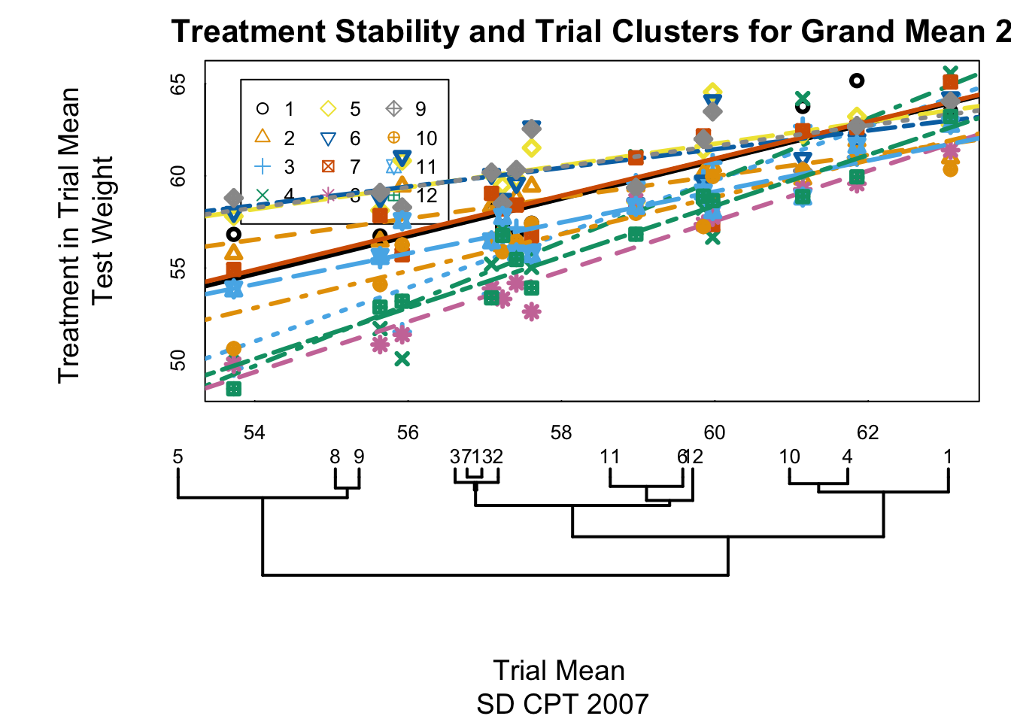
Types of nonadditivity
Nonadditivity λ=0.037
Nonadditivity λ=-0.178
(Data from South Dakota Crop Performance Trials, Winter Wheat, 2007)

Slide 24
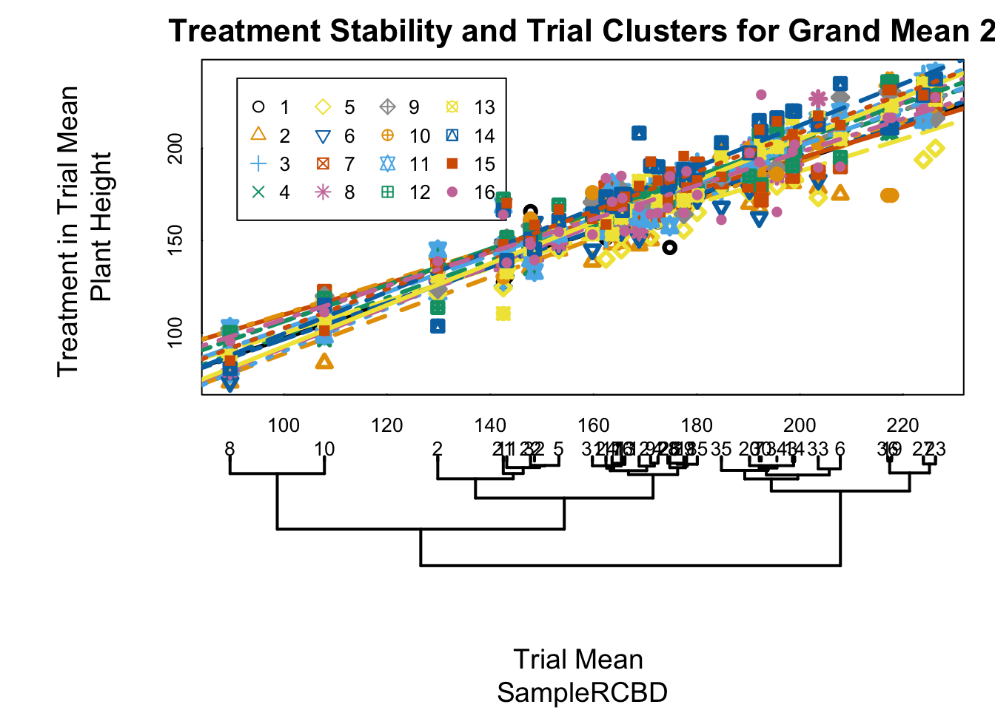
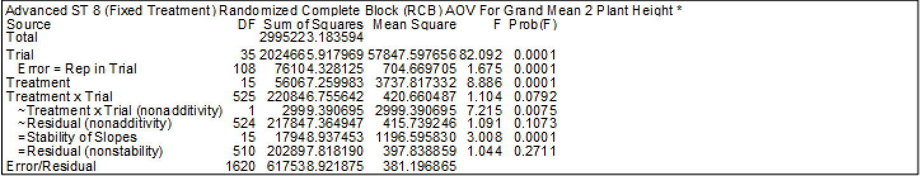
Concurrence
(Data from Vargas et al., 2013)

Slide 25
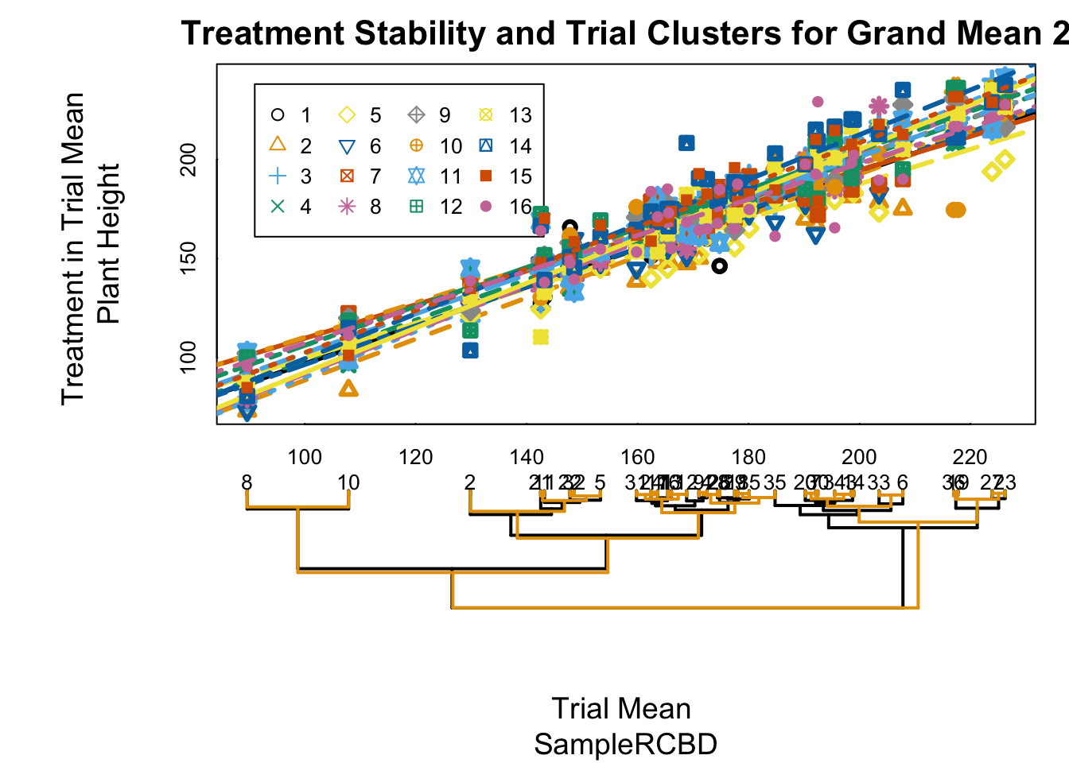
Concurrence
“Bundle of slopes”

Slide 26
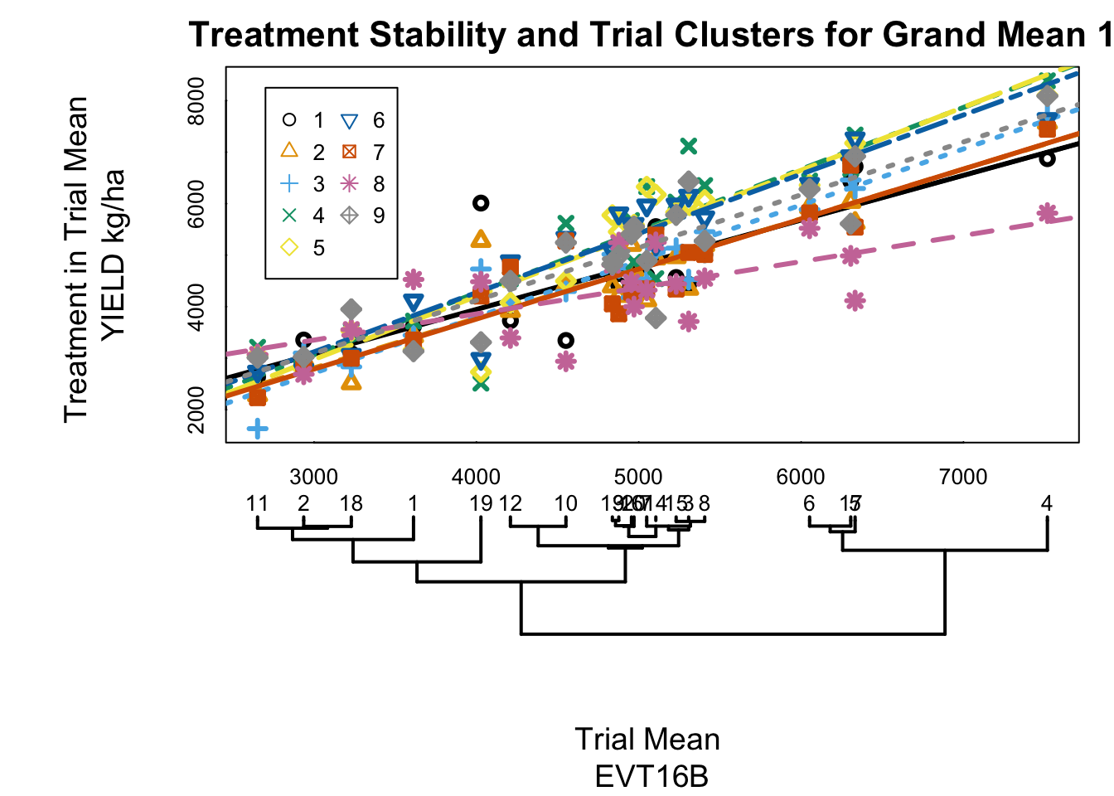
Complex Interaction
(Data from Cornelius et al., 1997)
Notes:
EVT16B.dat, SignMultModels, 3 sigma
[1] P. L. Cornelius, J. Crossa, and M. Seyedsadr. Statistical tests and estimators of multiplicative models for genotype-by-environment interaction. 1997.

Slide 27

Complex Interaction
Identify outliers by converting θ_{ιϕ} to Z distribution, circle treatment in trial means with score > 3
Notes:
EVT16B.dat, SignMultModels, 3 sigma
[1] P. L. Cornelius, J. Crossa, and M. Seyedsadr. Statistical tests and estimators of multiplicative models for genotype-by-environment interaction. 1997.

Slide 28
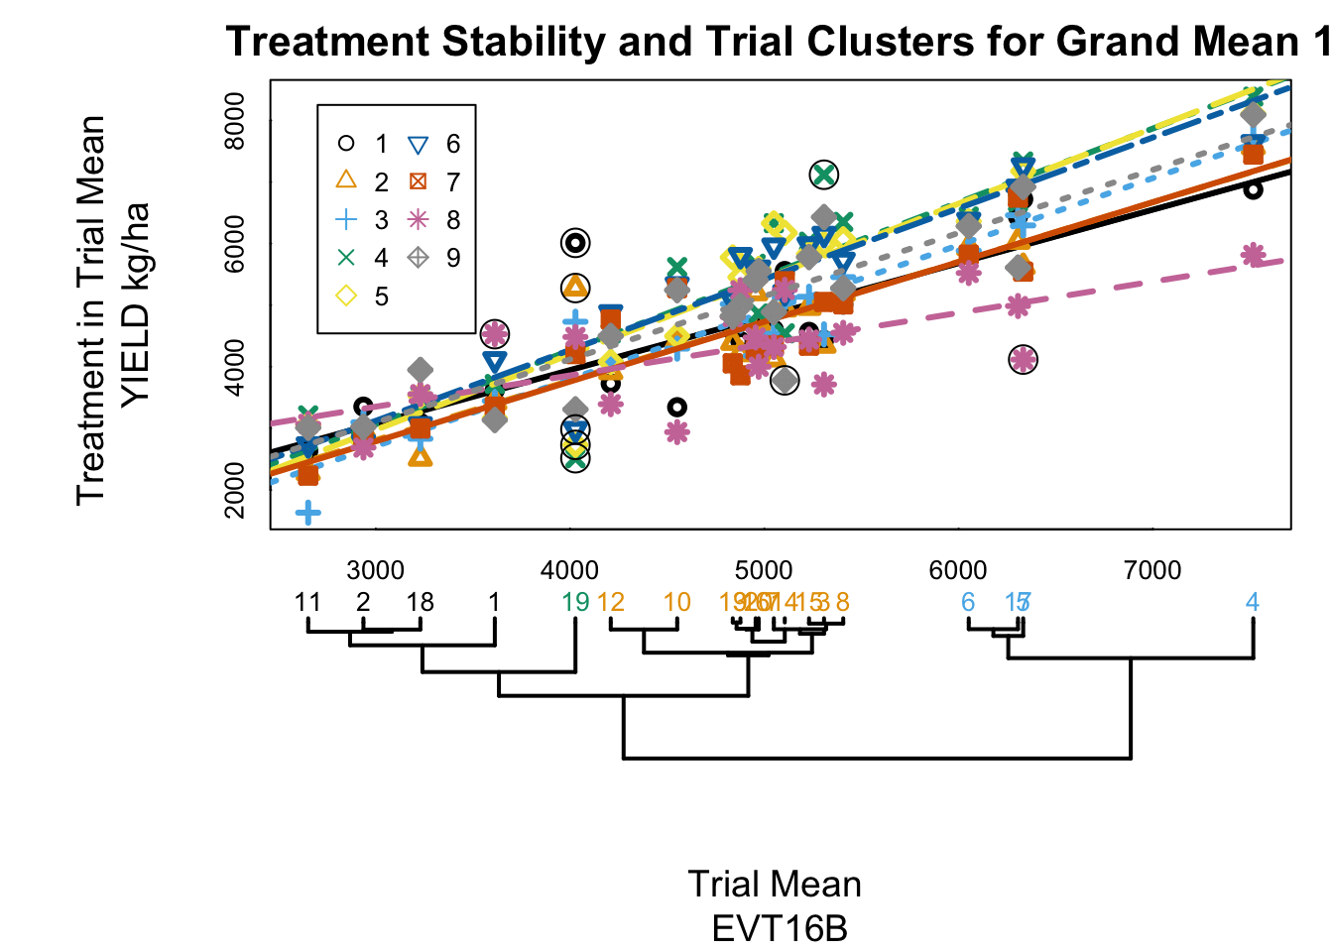
Complex Interaction
More outliers are found with score > 2
Colors identify clusters
One trial that forms its own cluster contains most of the outliers
Notes:
EVT16B.dat, SignMultModels, 2 sigma

Slide 29
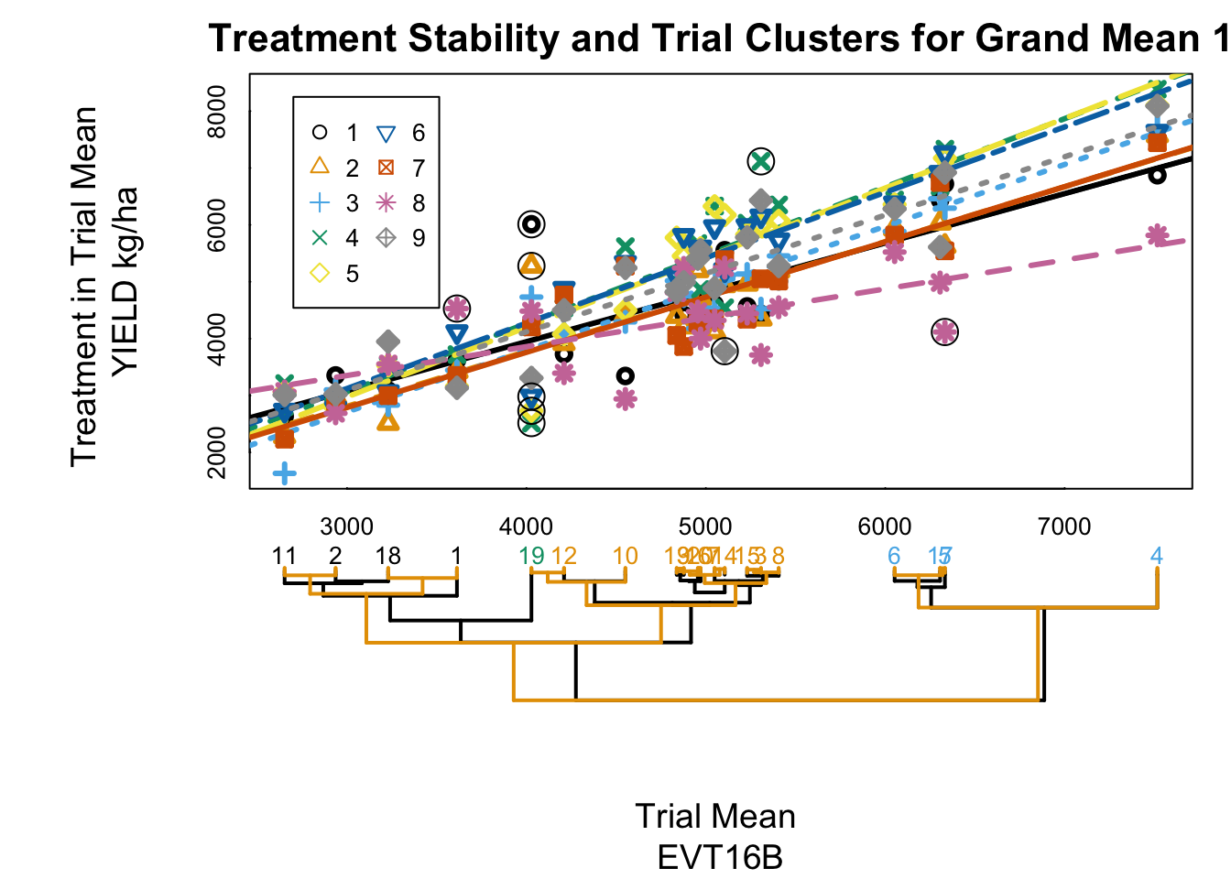
Complex Interaction
Reference dendrogram shows how interaction distorts trial dendrogram
Notes:
EVT16B.dat, SignMultModels, with reference dendrogram

Slide 30
Future Directions
Detailed decompositions
Linear-bilinear models (i.e. AMMI, SHMM)
Clustering methods and comparison of dendrograms
Automated analysis of trial groups
Covariate analysis
Use trial specific data to explain interaction
Geospatial maps

Slide 31
Decomposition of Interaction
Simple additivity
no interaction
Single random variable
interaction as error
Proportional to product of main effects
Tukey’s 1 d.f. test for non-additivity
One additional parameter measures interaction
Proportional to one main (trial) effect
Mandel’s heterogeneity of slopes
One additional parameter for each treatment
Other decompositions (concurrence, SVD)

